Slide 1
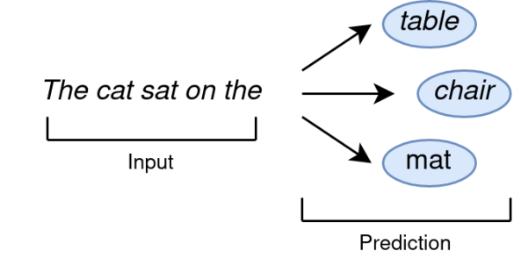
Large Language Models, what we call AI, like ChatGPT work by probabilities
The cat sat on the mat.

Slide 2
LLMs like ChatGPT work by probabilities
AI doesn’t know anything.
The probability model is absurdly complicated, but all it does is reproduce the relationships between the words on which it was trained.
LLMs generate text, not answers.
There is no reasoning.
So what can it do?
AI will offer “facts” that are hallucinations, especially the further you get from well-worn data (like python coding).

Slide 3
Data and History considers both the history of data and the data of history, and deeply relies on ChatGPT

Slide 4
In the AI age, you need code reading skills more than code writing skills
My class is structured around the same principles as this classic book for getting American historians through their foreign language exams in grad school.
Enough to read, but not enough to write.
Coding is not computer science.
Computer science is a rich discipline that considers information abstractly.
Coding is just talking in a very specific way to a computer.
ChatGPT allows anyone to code, with a little practice.

Slide 5
AI is an incredibly complementary technology for your particular skills
AI + Domain Knowledge
AI doesn’t, by itself, do anything. You need to apply it to your “domain knowledge” which is a nice way of saying whatever your unique work problems and frustrations are. Nobody else can tell you what AI can do for you.
AI is an assistant, not SkyNet
AI is a semi-reliable, way too enthusiastic intern who is good at oddly specific tasks related to language.
AI is a low-end tech consultant
AI can write totally standard, run-of-the-mill computer code for totally-normal problems, which are nearly all of your problems.
Image created with AI

Slide 6
ChatGPT is, for instance, extraordinarily good at writing computer code. I am not, but I want the computer to do my work for me.
Situation
Examples
Whenever I encounter something boring and repetitive, I ask Chat.
When I encounter something I would like to do, but don’t know how, I ask Chat
Turning thousands of image files in the right orientation
Turning 150 pages of 1950s variable codebook into code
Pulling all of a file type into a folder
OCR 19th century documents
Text summarization
PDF manipulation
Data analysis
Writing complicated Excel formulas
Graphing
Making PowerPoint tables
Writing drafts
Editing drafts
Use Google API
Etc.

Slide 7
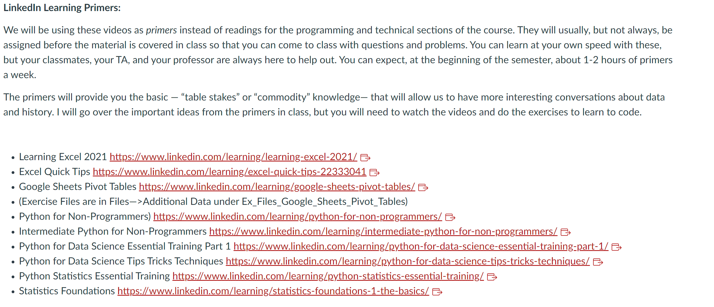
The technical skills rely heavily on LinkedIn Learning and ChatGPT

Slide 8
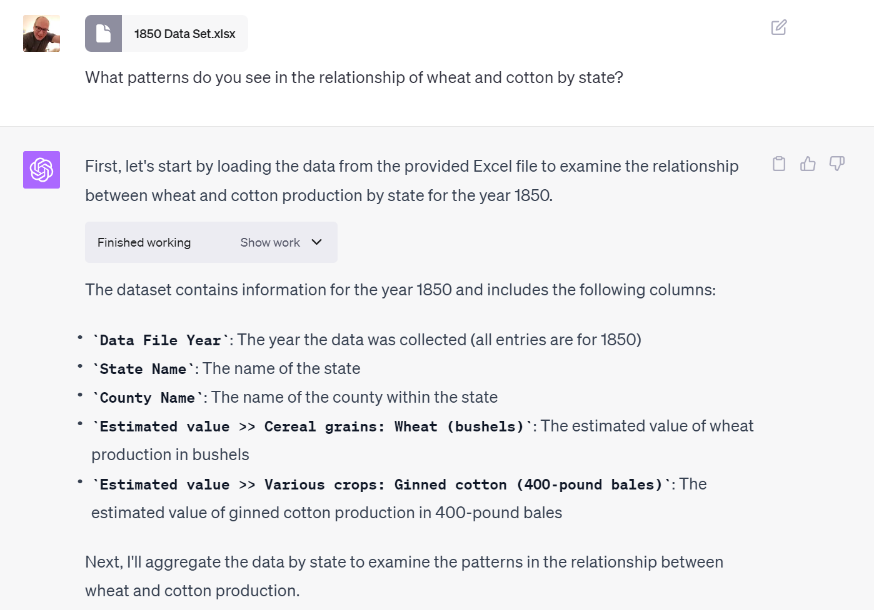
For example, Code Interpreter is very good at exploratory data analysis and clear programming questions.

Slide 9
Code Interpreter is very good at exploratory data analysis and clear programming questions.
You should check the code to see if it makes sense.
And since Chat runs the code, it can’t hallucinate. If the code doesn’t run, it corrects itself
import matplotlib.pyplot as plt
import seaborn as sns
# Set up the matplotlib figure
plt.figure(figsize=(18, 10))
# Scatter plot for examining the relationship between wheat and cotton production by state
sns.scatterplot(data=df_statewise, x='Estimated value >> Cereal grains: Wheat (bushels)', y='Estimated value >> Various crops: Ginned cotton (400-pound bales)', hue='State Name', palette='tab20', s=100)
# Annotate each point in the scatter plot with the state name
for line in range(0, df_statewise.shape[0]):
plt.text(df_statewise['Estimated value >> Cereal grains: Wheat (bushels)'][line]+20000,
df_statewise['Estimated value >> Various crops: Ginned cotton (400-pound bales)'][line],
df_statewise['State Name'][line],
horizontalalignment='left',
size='medium',
color='black')
plt.title('Relationship between Wheat and Cotton Production by State in 1850')
plt.xlabel('Wheat Production (Bushels)')
plt.ylabel('Cotton Production (400-pound bales)')
plt.grid(True)
plt.show()

Slide 10
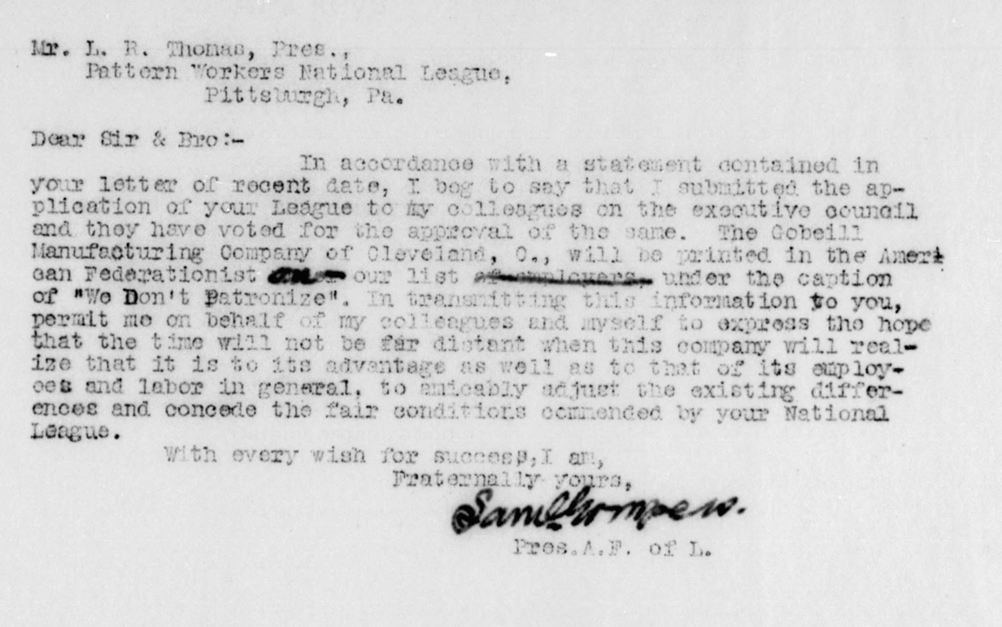
Students learned data science math, but also historical techniques like OCR

Slide 11
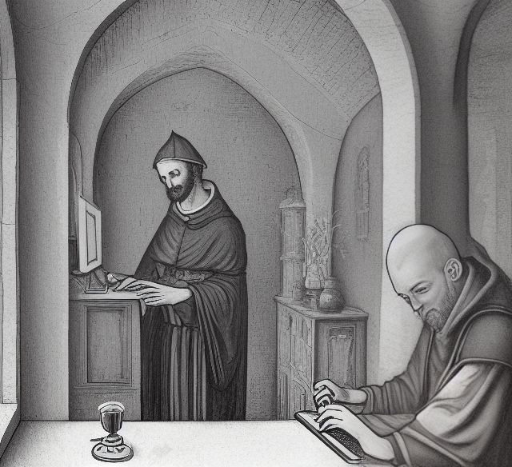
ChatGPT writes code to use the Google and ChatGPT APIs to OCR and clean the text
Break Dirty Text into smaller chunks to fit under token limit
Send to LLM with zero temperature
Receive Cleaned Text
Reassemble Cleaned Text
API Process
Used Google Vision API
Used
ChatGPT API gpt-3.5-turbo
Image source: Easy Diffusion “create a picture that looks like a lithograph with a medieval christian monk and a computer. the setting is a scriptorium.”

Slide 12
RAW
OCR
33
Mr. L. R. Thonas, Pres.,
Pattern Workers National League,
Pittsburgh, Pa.
July 31,
With every wish for succesp, I am,
Fraternally yours,
Dear Sir & Bro:-
In accordance with a statement contained in
your letter of recent date, I bog to say that I submitted the ap-
plication of your League to my colleagues on the executive council
and they have voted for the approval of the same. The Cobeill
Manufacturing Company of Cleveland, O., will be printed in the Ameri
our list aluar under the caption
can Federationist
of "We Don't Patronize". In transmitting this information to you,
permit me on behalf of my colleagues and myself to express the
that the time will not be far distant when this company will real-
ize that it is to its advantage as well as to that of its employ-
oes and labor in general, to nicably adjust the existing differ-
ences and concede the fair conditions commended by your National
League.
이
Sanelompe w.
Pros. A.P. of L.
Mr. L. R. Thomas, President,
Pattern Workers National League,
Pittsburgh, PA
Dear Sir & Bro:
In accordance with a statement contained in your letter of recent date, I beg to say that I submitted the application of your League to my colleagues on the executive council and they have voted for the approval of the same. The Cobeill Manufacturing Company of Cleveland, OH, will be printed in the American Federationist under the caption "We Don't Patronize". In transmitting this information to you, permit me on behalf of my colleagues and myself to express the hope that the time will not be far distant when this company will realize that it is to its advantage as well as to that of its employees and labor in general, to amicably adjust the existing differences and concede the fair conditions commended by your National League.
Sincerely,
W. Sanelompe
President, A.P. of L.
CLEAN
The OCR was gibberish.
After the LLM, the results were nearly perfect.

Slide 13
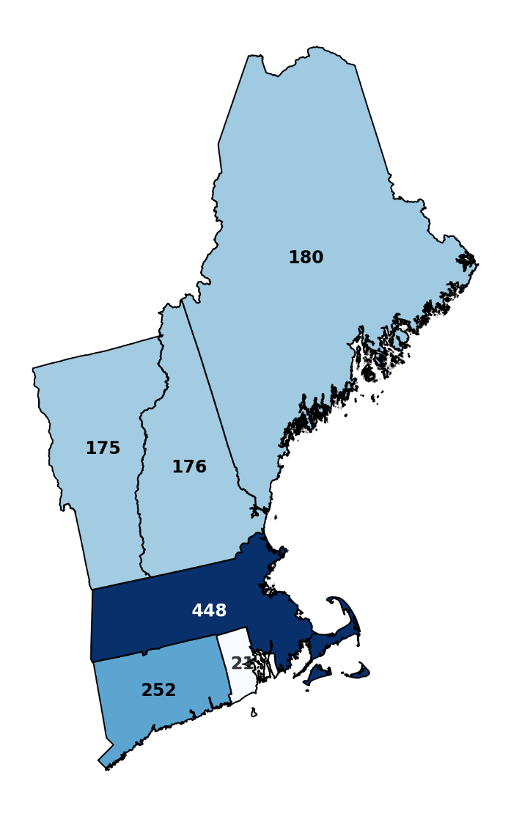
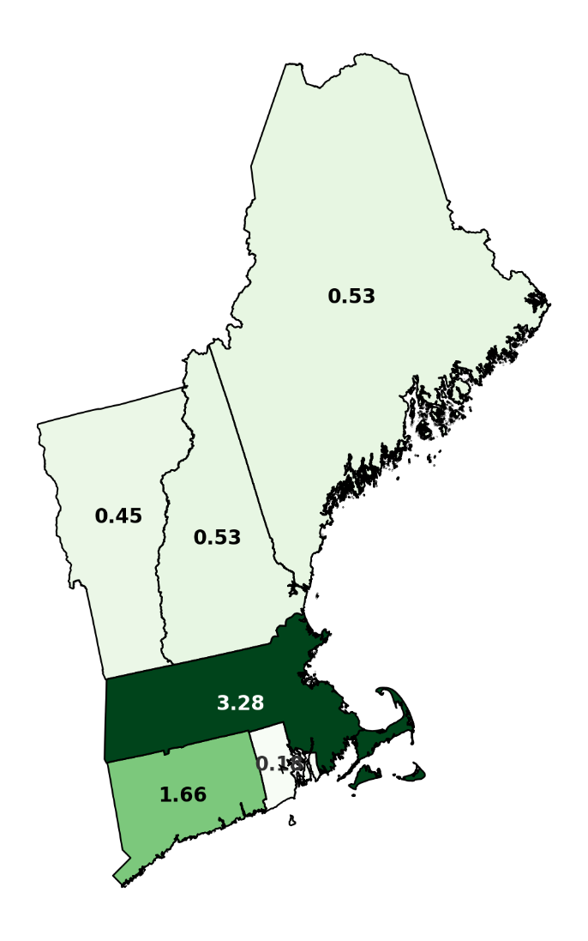
Students also learned to do visualizations, like plotting and mapping with Python.
Congregational churches in New England (1850)
#
Value of Congregational property in New England (1850)
$millions

Slide 14
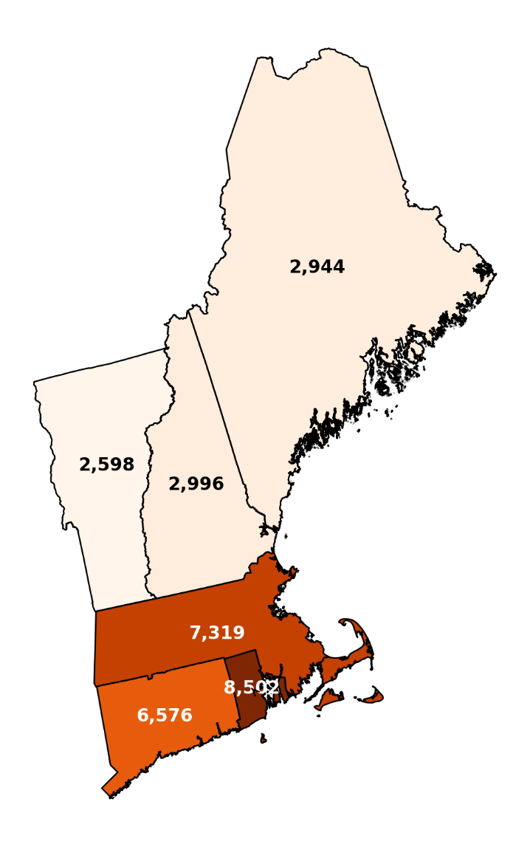
Mapping in this way is as powerful as GIS
Value per Congregationalist Church in New England (1850)
$ per church
Revision is still necessary!

Slide 15
The assignments started with basic spreadsheet skills and progressed all the way to complicated data analysis.
Assignment 4: Poverty or Progress?
An essential part of the story of American history is the immigrant who comes from overseas and, despite adversity, succeeds. This rags-to-riches narrative is powerful in our culture. In the Anbinder reading, you saw some very persuasive evidence that for Irish servants, it was in fact the case—at least they were able to save some substantial sums. Yet, we have also read stories of labor exploitation, from indentured servants to sweatshop workers.
This project will give you the opportunity to complicate some aspect of the Anbinder argument using his own data.
In this project, you will come up with your own question and use the data to answer it.
When using data, it is important to have a hypothesis about what you think is the case (e.g, women from different counties in Ireland may have had different saving rates), so that you don’t end up spinning your wheels as you analyze the data.
You may also flesh out your argument with individual lives. If so, I would suggest combining the Anbinder data with https://www.ancestrylibrary.com/ (which you should access through the Cornell library at https://newcatalog.library.cornell.edu/catalog/5508453 )
Feel free to use statistics, graphs, visualizations, maps, or any other kind of analysis. Draw on data analysis techniques from this and your other classes.
The important part is moving from analysis to argument. No data is self-evident. It must be turned into a narrative that answers the question.
The deliverable from this project is open-ended, but it will need to make an argument about the past. You may write a short analytic paper. You may make a historical map with annotation. You may make a powerpoint presentation. You may be imaginative.
While I have posted some of the Anbinder data set on the Canvas site, you can find more aspects on his curated data site.
http://beyondragstoriches.org/home-exhibit

Slide 16
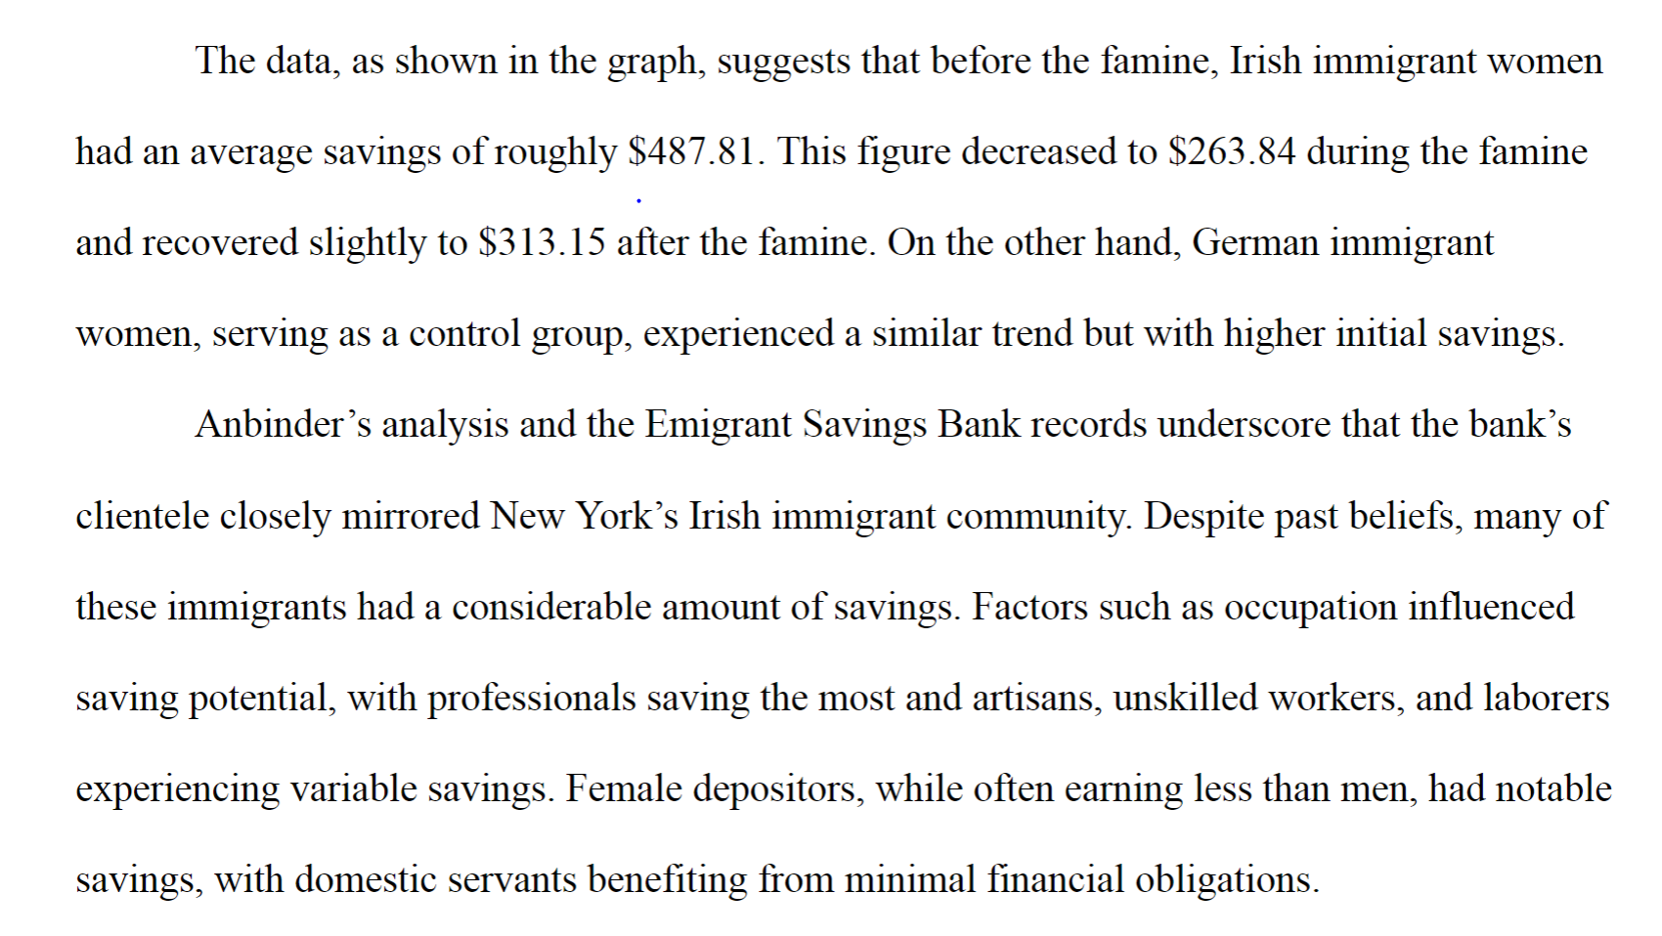
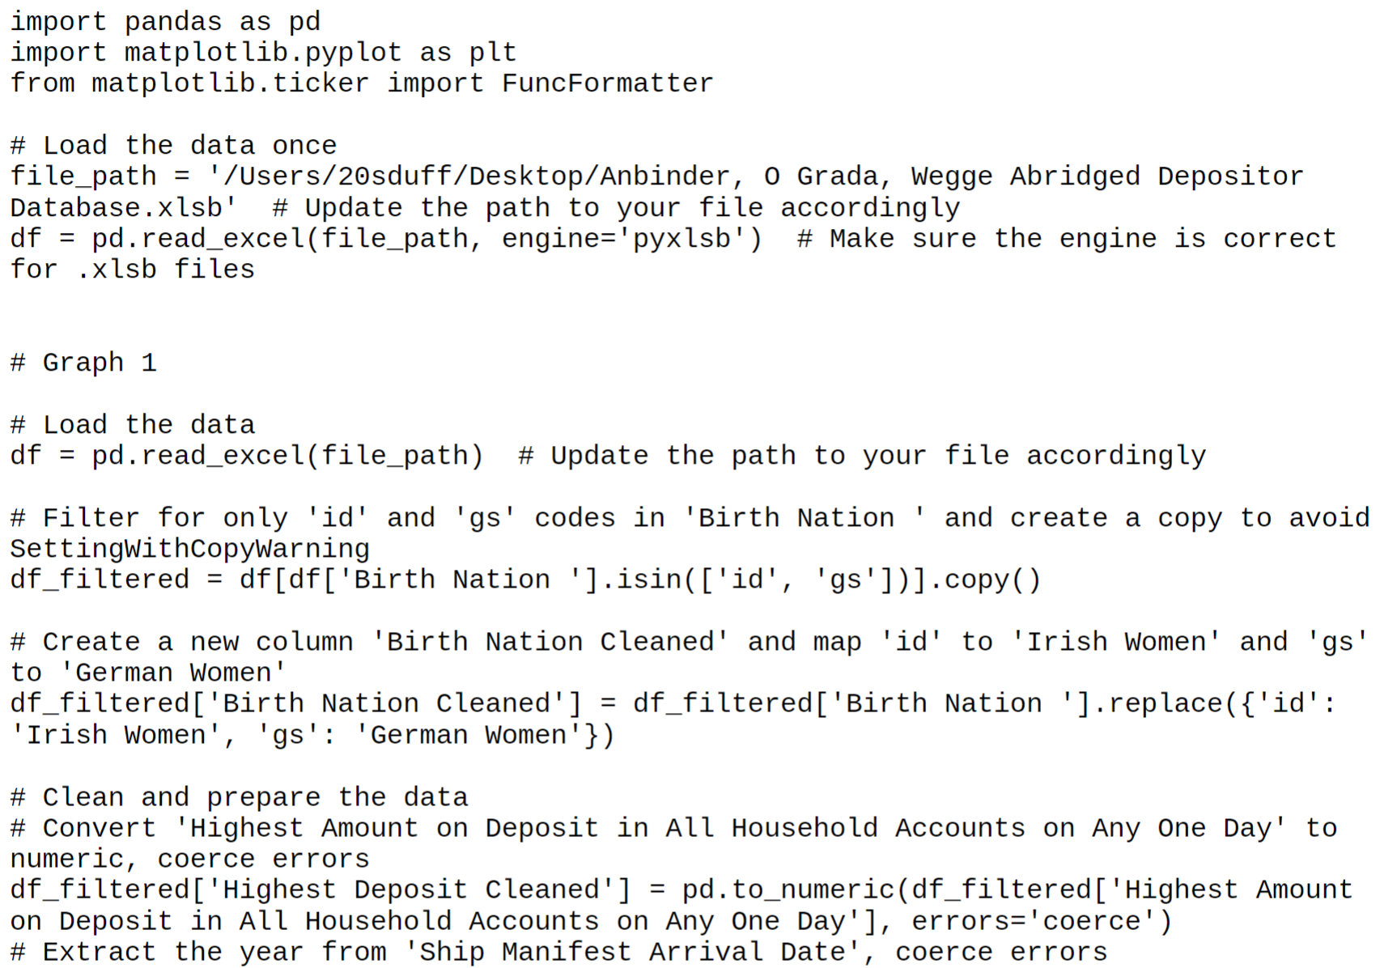
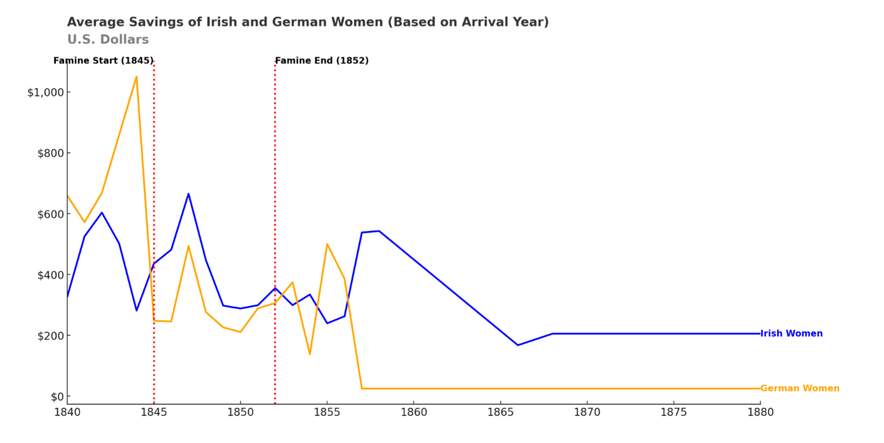
Students need to provide conventional writing as well as working code.
For the later assignments, students turn in a normal history paper, complete with visualizations, as well as the python code that generates the key analyses.

Slide 17
Categories | A | B | C
Original Analysis (25%) | Originality in formulating research question and hypothesis. Demonstrates deep understanding of the Anbinder argument and offers a nuanced critique. | Research question and hypothesis is perhaps obvious but still of merit. Critique of Anbinder argument is present but lacks some depth. | Unclear why this argument would be interesting. Little to no critique of Anbinder argument.
Historiography (20%) | Excellent integration of other scholarly works, including readings from class. Builds on or contradicts existing historical narratives effectively. | Good use of other scholarly works but may lack in tying these effectively into the research question or hypothesis. | Minimal or poor use of other scholarly works. Does not effectively use these to bolster or challenge the research question or hypothesis.
Data Science (20%) | Exceptional use of data analysis techniques. Code is well-organized and commented. Code runs from original files. Statistical techniques are used appropriately. Data sets are linked in ways to advance new arguments. | Good use of data analysis techniques. Code is mostly organized and somewhat commented. Code runs only after tinkering. Statistical techniques are used, but with some errors or inappropriately. Data sets are used independently. | Minimal or poor use of data analysis techniques. Code is disorganized or lacks comments. Code does not run. Statistical techniques are absent, largely incorrect, or misinterpreted. Only one data set is examined.
Writing (20%) | Excellent organization and clarity. Thesis is clear and the paper is free of grammatical errors. Consistently argumentative topic sentences. Correct use of Chicago/Turabian style citation format. | Decent organization and clarity but may contain some minor grammatical errors. Argument unclear at times. Any other citation format except Chicago/Turabian. | Poor organization and/or multiple grammatical errors. Unclear argument. Tends towards a “data damp” than making sense of the evidence. No consistent citation format.
Visualization (15%) | Exceptional use of visualizations that significantly aid in understanding the analysis. High-quality, clearly labeled, and well-integrated into the narrative. All visualizations follow standard format. Visualizations clearly considered in a way to advance arguments. | Good use of visualizations but may lack in quality or integration into the narrative. Visualizations somewhat deviate from standard format. Some visualizations are there, but no the ones that would make the most impact. | Minimal or poor use of visualizations. Low-quality or not well-integrated into the narrative. Visualizations look unconsidered and default. Visualizations exist but are unrelated to analysis.

Slide 18
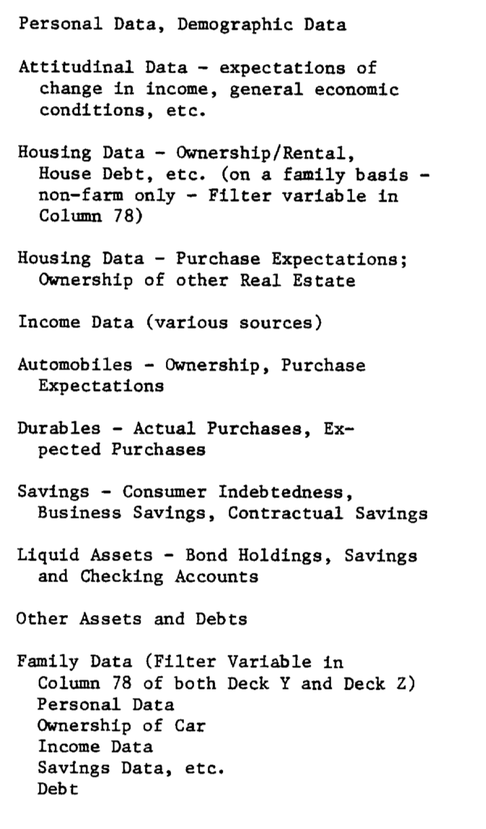
By the end of the semester, they are analyzing real, dirty data sets. The Survey of Consumer Finance of 1950 offers a window into the financial lives of Americans in the past
By the use of this data we can ask important questions about the past.
And we can do analyses that the Surveyors in the 1950s did not (like examine the different financial experiences of black and white Americans.)

Slide 19
The data is a codebook and an ASCII file structured like a punchcard in columns and rows.
This column for instance marks which “card” is being referred in the row.
This 4 digit code is for place (in this case, Adair, MO)
These columns are the weight for that card

Slide 20
Assignment 5: Survey of Consumer Finance, 1950
The Survey of Consumer Finance contains all the opportunities for insight and myopia that Bouk and Igo write about.
What questions will you ask? What arguments will you make? How will you place it in historical context?
Here is the link to the website for the original data. https://www.icpsr.umich.edu/web/ICPSR/studies/3612
This assignment is very unstructured and will require a lot of work. The files have two parts: a codebook in PDF form and a very large ASCII file that replicates the original punchcards. You will need to find a way to “read” in the data from the ASCII file so that you can analyze it. You will need to ask good questions that were perhaps not asked in 1950. Data will need to be cleaned. So many problems to solve! So real!
For this assignment, the deliverable will be two papers. First, you will write a conventional historical paper of 3000 words (10-15 pages) making an argument about consumer finance in 1950. You will need to include visualizations. Second, you will write a technical paper of 1000 words (3-5 pages) that describes what you did and defends your technical analysis. In a separate file, you will need to include all the raw data and python code for your analysis (including that generated by ChatGPT). The TA/Professor should be able to run the code to generate all key analyses and graphs starting with the raw data, including clean up code.
FILES TO GET YOU STARTED
Codebook SCF 1950 Final Version.xlsxDownload Codebook SCF 1950 Final Version.xlsx
codebook_small.txtDownload codebook_small.txt
03612-0001-Codebook-card_image.pdf
03612-0001-Data-card_image.txtDownload 03612-0001-Data-card_image.txt
Grading Rubric .pdf

Slide 21
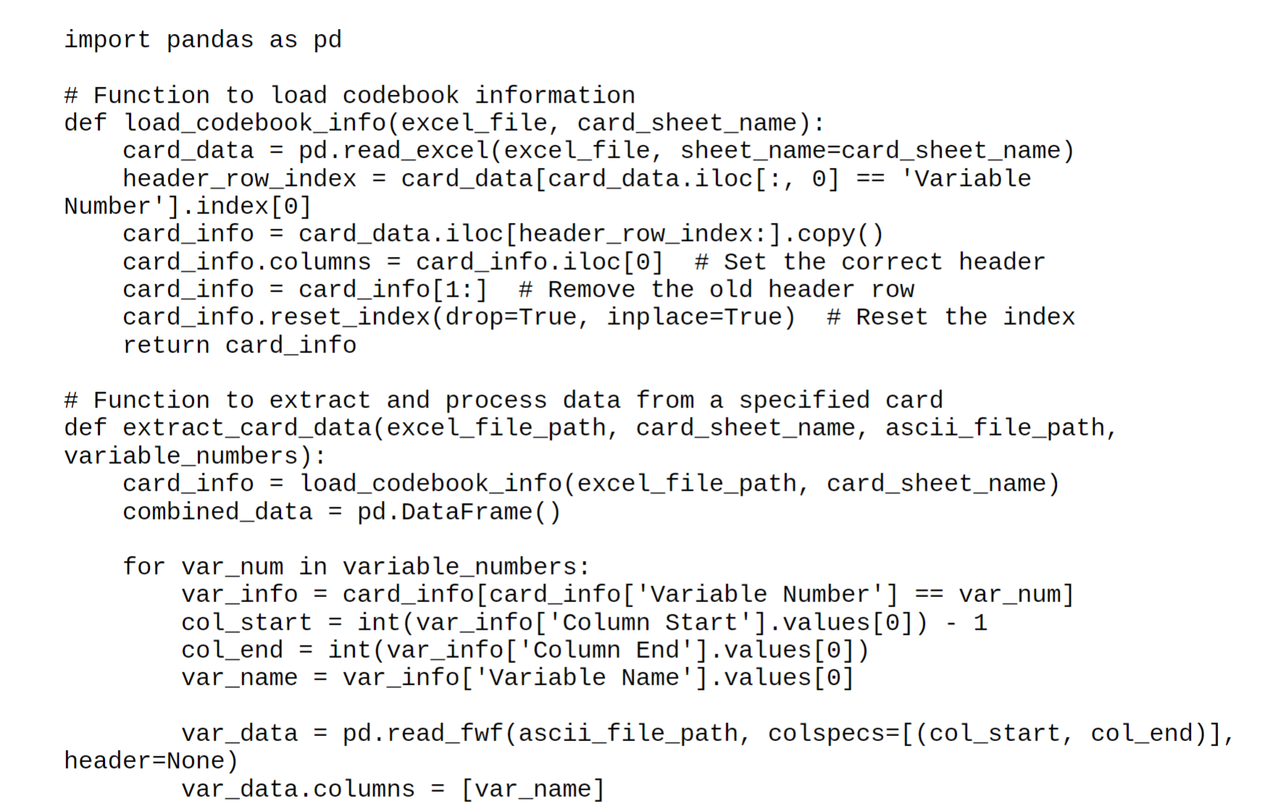
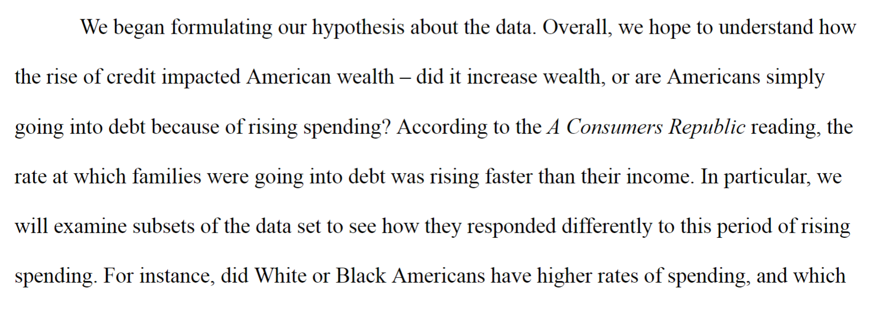
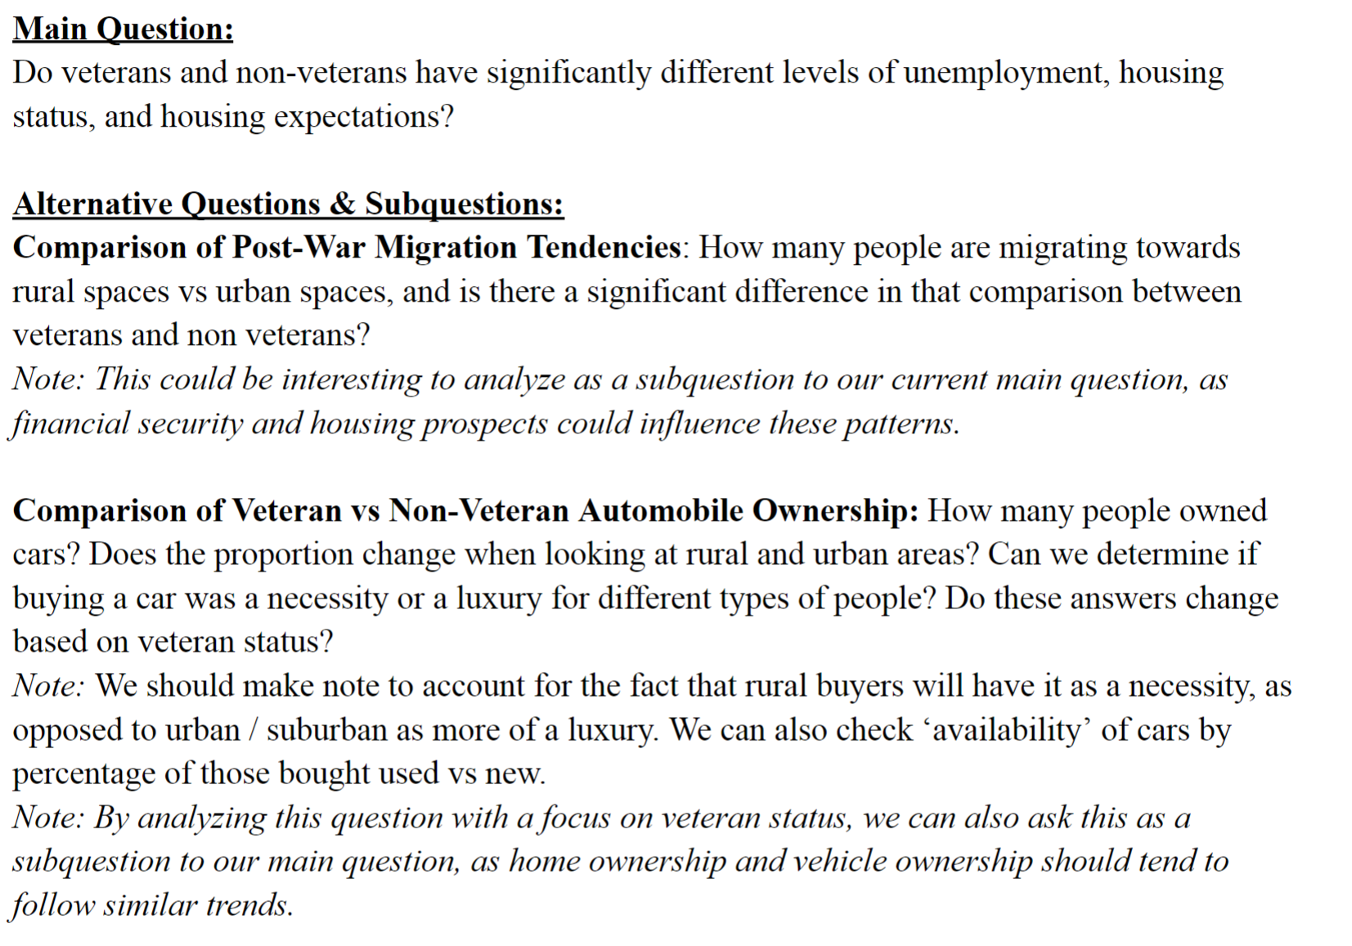
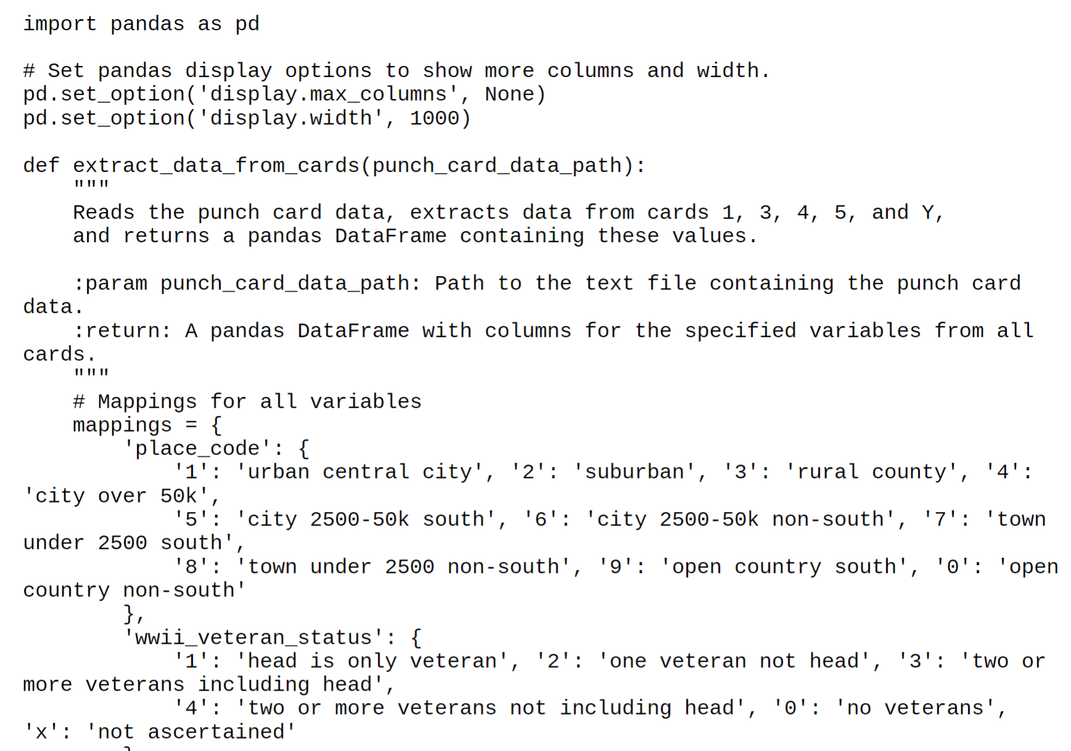
Students figure out how to read the data, label the variables, analyze the variables and make novel arguments.

Slide 22
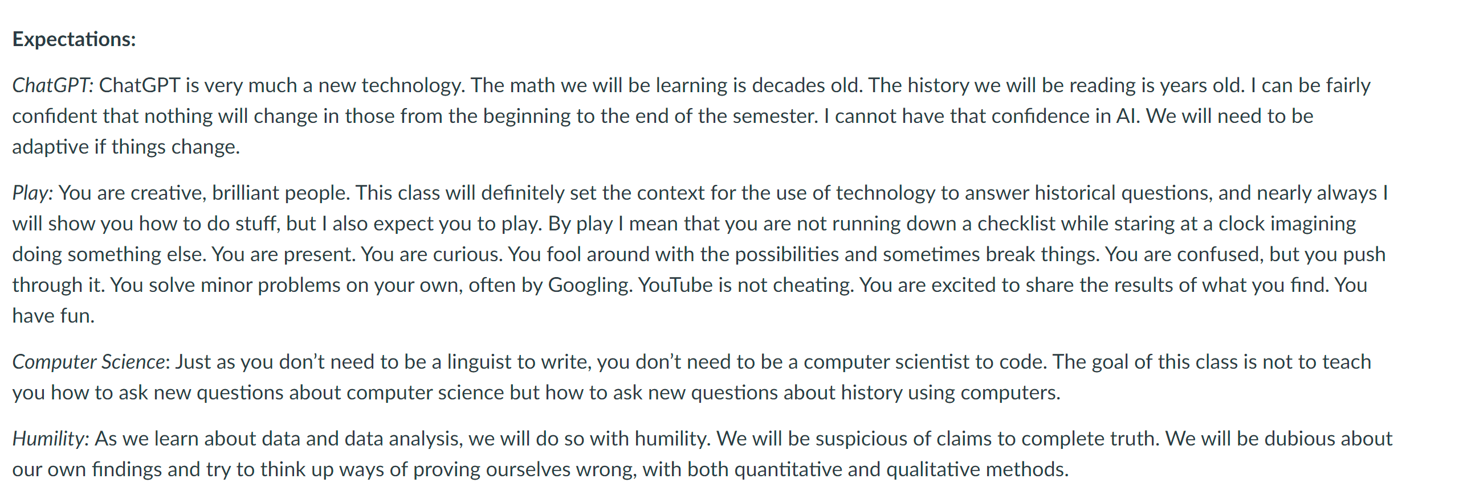
Students struggled with both the pace of the class and what Chat meant for “their work.” They were not used to being self-motivated in learning.
To accomplish the tasks, students needed to lean heavily on Chat to do the coding work, so they could focus on high-level questions.
This was confusing for some of them.
The value of humans in the age of AI is asking human questions, and using machines to get answers.
They were more accustomed to memorizing the answer than asking the question.

Slide 23
D&H was as rewarding to teach as it was challenging
Successes
Students are fluently using APIs, libraries, and code to connect quantitative evidence and historical argument.
Students ask and answer statistical questions on their own, and decide on the appropriate tests.
Students developed critical thinking skills related to data sets. “Data as document” was extremely compelling to non-history students.
Challenges
Students are not accustomed to creating their own questions and sometimes struggled to do so.
Some students lacked basic computer literacy (e.g., that files should be organized in folders).
Students seemed surprised that they needed to know something from the previous month.
Students seemed to lack “intuition” about mathematics
Failures
Group work is necessary, but, as always, there are free-riders
Some students wanted more “history of data” than “data of history.” It was challenging to teach to students with varied backgrounds in math, CS, and history.

Slide 24
Thank you!
Contact:
louishyman@jhu.edu

