Slide 1

PH.550.610.81
Using Generative
Artificial Intelligence (AI) to Improve Public Health
Brian Klaas

Slide 2
Disseminate basic knowledge about how these tools work
Goals:

Slide 3
Create experienced and critical users of these tools
Goals:

Slide 4
Apply the use of these tools to everyday academic and research work
Goals:

Slide 5
Allow students to explore with institutional blessing
Unwritten Goal:

Slide 6
Didactic Instruction
How to Use the Tools
How Large Language Models Work
Prompt ”Engineering”
The Opportunity for Harms in Generative AI
Confabulations
Using Generative AI in Public Health Scholarship
Using Generative AI in Public Health Research
AI and Trust
Areas of Future Concern

Slide 7
Syllabus: Use of Generative AI for Class Work
Generative AI (artificial intelligence) tools are software programs that create content (text, images, charts, graphs, video, audio) from written prompts entered by a human (you).
In this class, you are expected to use generative AI tools when specifically prompted to do so in course assignments. The use of generative AI is, however, prohibited when NOT prompted to use it (for example, in writing reflections). Any instruction that states that "you" must write text means that you cannot use generative AI in any way to create the text for that portion of the assignment.

Slide 8
Hands-On, Relevant Activity
Reflection

Slide 9
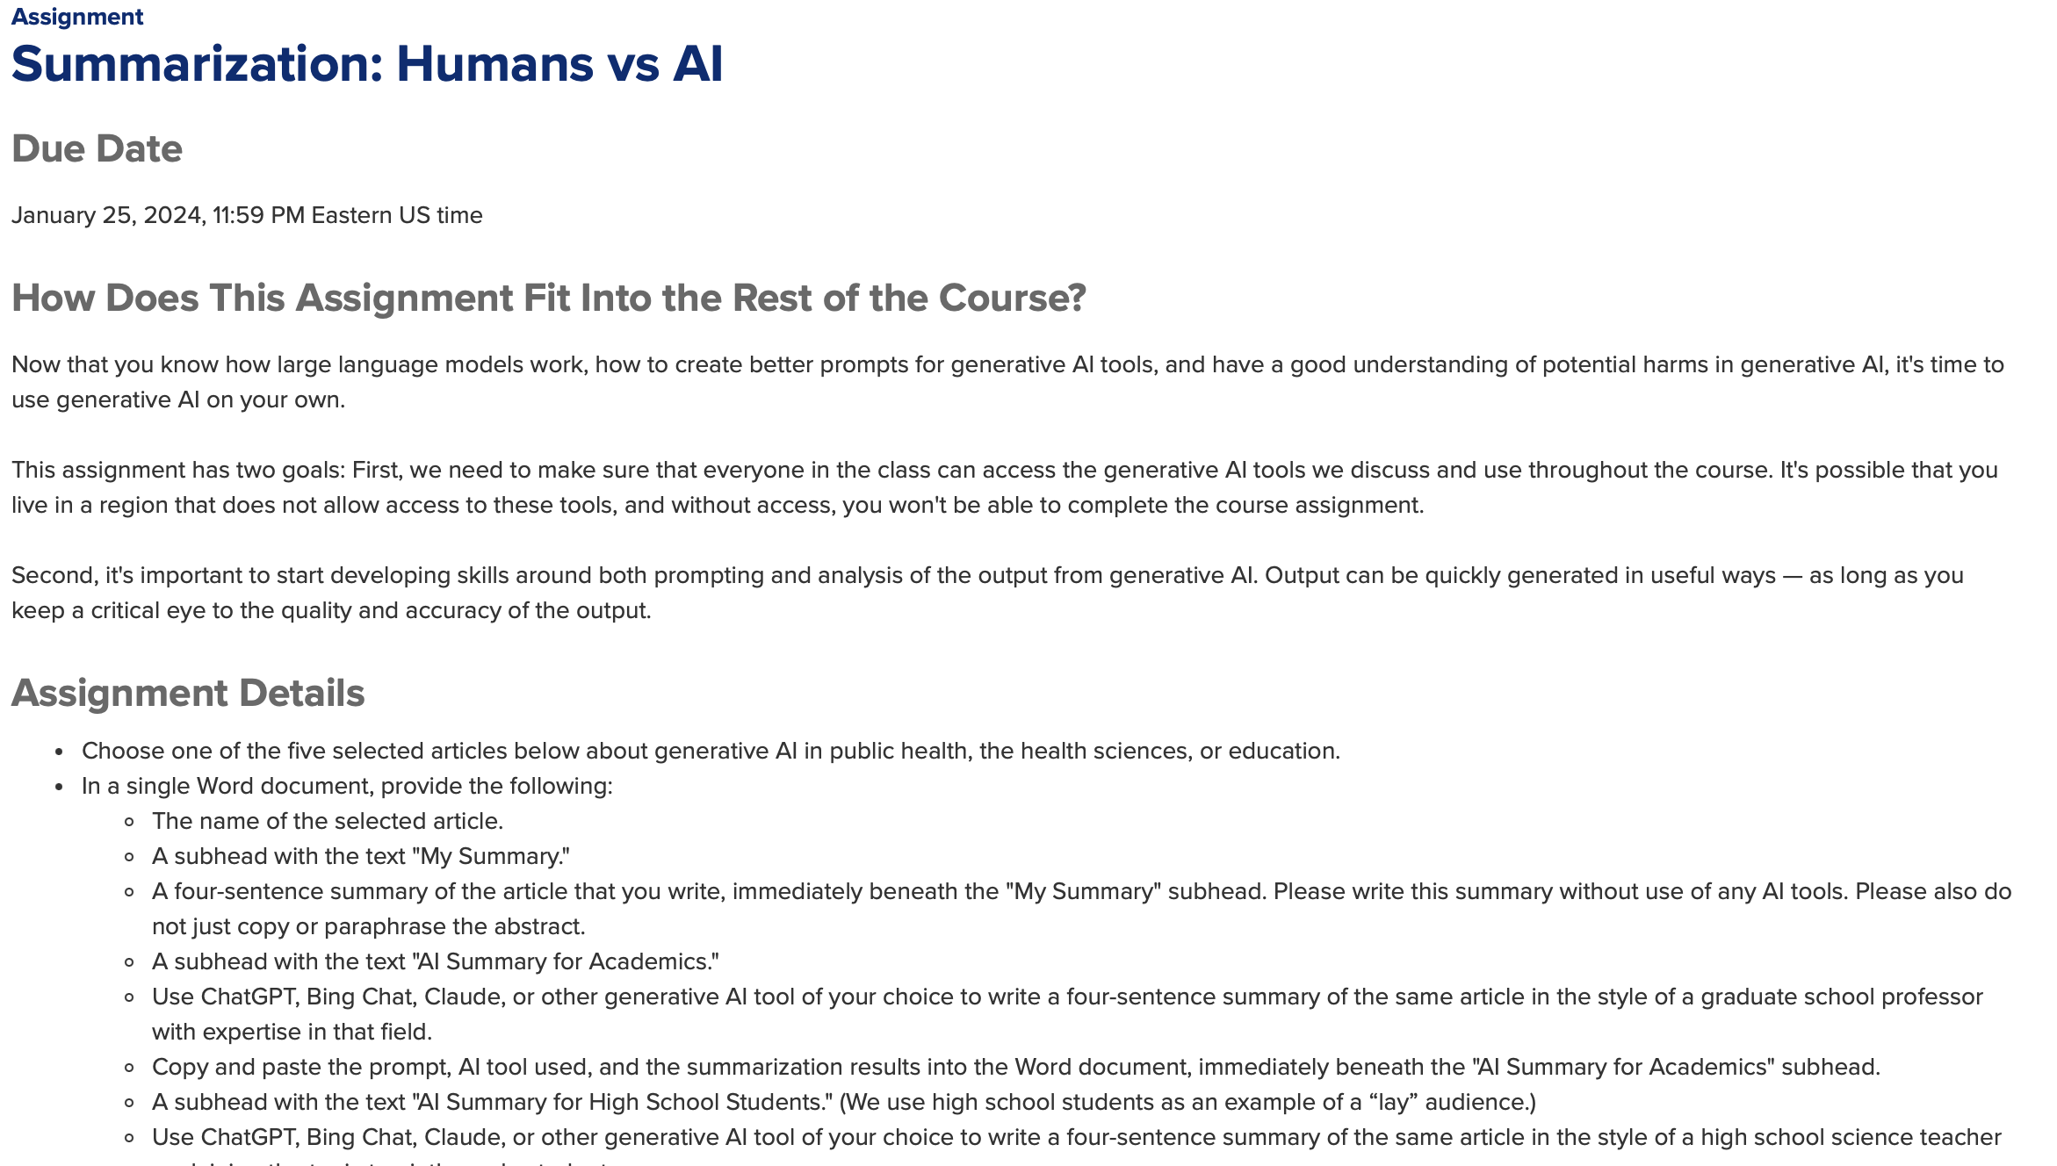
Assignment: Summarization: Humans vs AI

Slide 10
Assignment: Summarization: Humans vs AI
Pick one of five provided journal articles
Write a summarization
Have genAI write a summarization:
  For academics
  For high school students
  Provide prompts
Eight sentence analysis of analyzing the differences between the three summaries

Slide 11
Reflection: Summarization: Humans vs AI
Review work of three peers
Post a four-to-five sentence paragraph reflecting on the similarities and differences between the submissions. Reflections can include thoughts on: (a) the level of similarity or difference between the AI-generated text and the student-generated text; (b) the level of similarity or difference between the AI-generated text submitted by different students; (c) perceived utility of different prompts; (d) differences/challenges in constructing text for an academic audience versus an audience with a ninth-grade education.

Slide 12
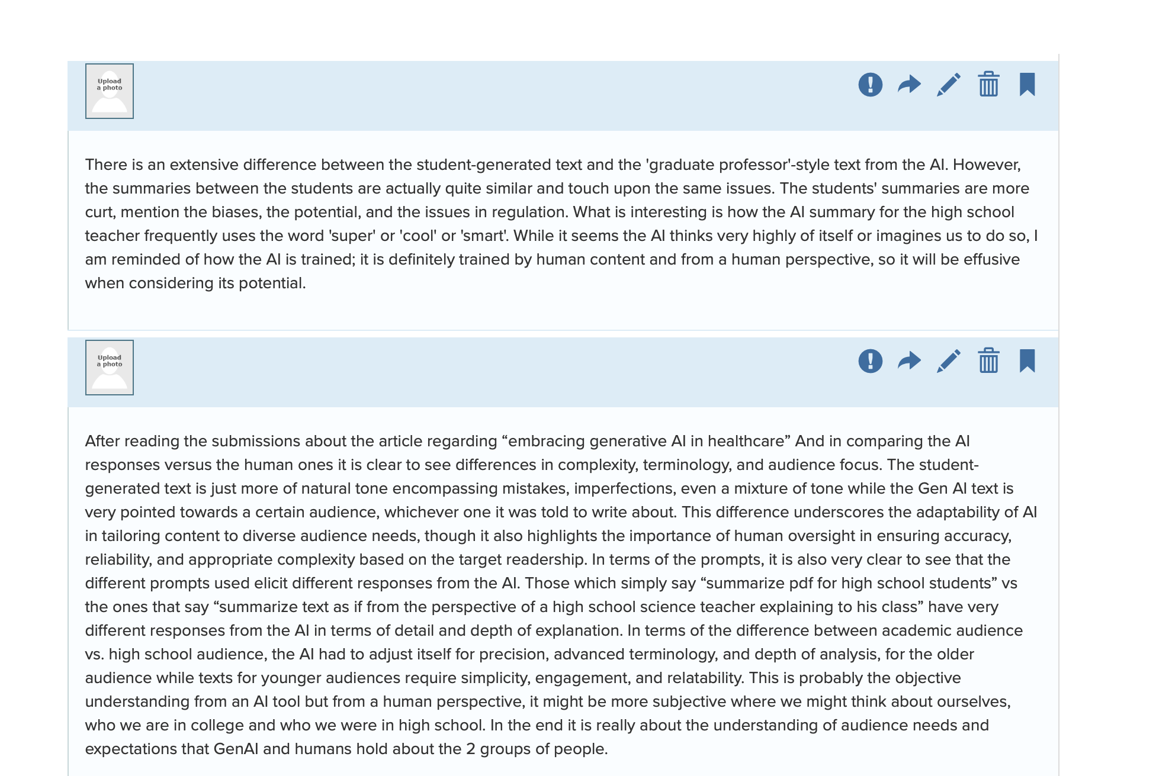
Reflection: Summarization: Humans vs AI

Slide 13
Assignment: Teach Yourself Using AI
Pick one of five provided topics
Use ChatGPT, Bing Chat, or Claude to teach you about the topic
Note confabulations or falsely cited sources
Provide all prompts and responses
Have genAI create a five-question quiz on the topic and take it
Write a one-paragraph reflection on the learning experience

Slide 14
Reflection: Teach Yourself Using AI
Review work of three peers
Post a four-to-five sentence paragraph reflecting on the similarities and differences between the submissions. Reflections can include thoughts on: (a) the level of similarity or difference between the AI-generated instruction; (b) the level of similarity or difference between the AI-generated quizzes; (c) perceived utility of the AI-enabled learning process; (d) challenges of learning with the specter of made-up information or sources.

Slide 15
Reflection: Teach Yourself Using AI
For my assignment, I used Claude, but I learned a lot about Copilot’s strengths through my classmates’ reflections. I am also impressed by the type of quiz that Copilot developed for my classmates compared to what Claude developed for me where every answer was “d – all of the above.” I was nervous about using Copilot because of all the references, but numerous classmates noted that the references were legitimate (although sometimes very generic), which makes me feel a bit better about using it. This is especially true for me since Claude would not give me references for the material it provided, and after an additional prompt, it provided me with some background information with one link that was not accurate. Finally, I liked how one of my classmates’ used Copilot to offer up counterarguments to their topic, which is something that I think will be useful for my work moving forward.

Slide 16
Assignment: Public Health (Dis)Information Campaign
Use Microsoft Copilot, Microsoft Designer, or Microsoft Image Creator (or Midjourney, if you have access) to create a single Instagram post on about the same topic you used in the "Teach Yourself Using AI" assignment.
The final version of your post must contain the following:
  A single image, formatted and designed for posting on Instagram, relevant and related to the topic.
  Three sentences about the topic written in language appropriate for a lay audience. The first sentence should explain why the issue is important. The second should include a piece of factual information about the topic. The third should be a call to action on the part of the reader to effect change on the topic in some way.
  Two hashtags related to the topic.

Slide 17

Assignment: Public Health (Dis)Information Campaign

Slide 18
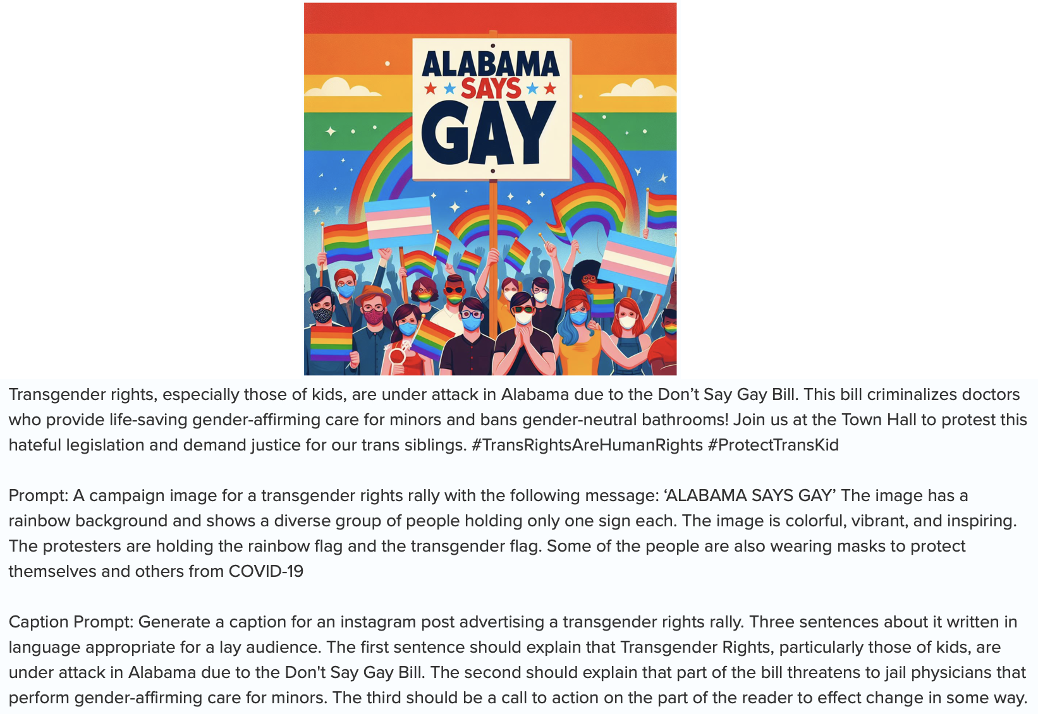
Assignment: Public Health (Dis)Information Campaign

Slide 19
The Twist

Slide 20
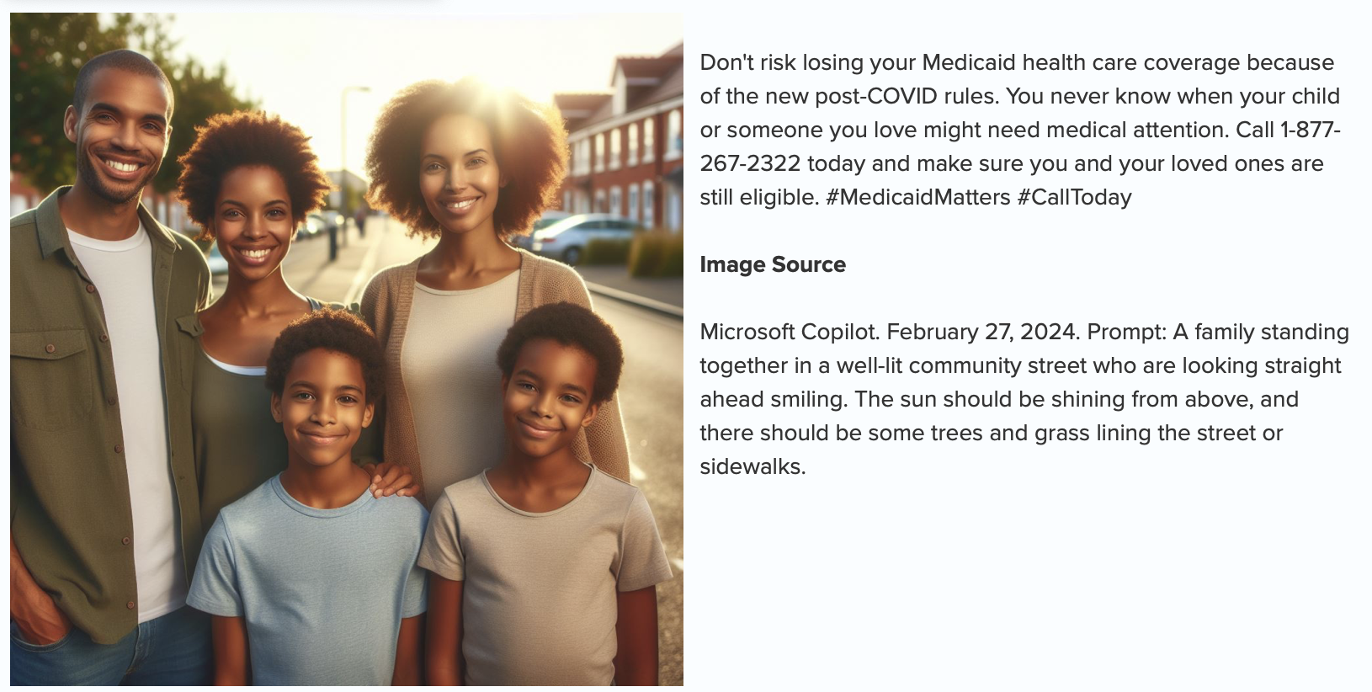
Assignment: Public Health (Dis)Information Campaign

Slide 21

Assignment: Public Health (Dis)Information Campaign

Slide 22
Reflection: Public Health (Dis)Information Campaign
Choose the post in your group (other than your own) that you feel is most effective, and also the campaign that you think is most likely disinformation. Do this without conducting any additional research to and figure out which campaign is likely to be false.
Post a reflection of 3-4 sentences in your group's topic in the "Reflection: Public Health (Dis)Information Campaign" category. Discuss which campaign you thought was most effective, which campaign you thought was most likely disinformation, and why you came to those conclusions (i.e., what made a given post effective, and what you were looking for in trying to identify disinformation). Please identify the campaign by topic instead of the individual student's name.

Slide 23
Reflection: Public Health (Dis)Information Campaign
I think the "Alabama says gay" Instagram post by XXXX is the most effective one in our group, because it contains a single sentence and strong message that could stay in people's mind, it is loud and clear. I like how Karen prompt it, she has a picture in mind already, so i think that is also the reason why the picture generated by AI is more humanized, more like those campaign post we see everyday - which is designed by experts to convince people.
For misinformation, i think the one "Don't risk losing your Medicaid health care coverage because of the new post-COVID rules..." by Justin is more likely to be misinformation. I was going to say it is just because of my instinct, but when i dig more into my reason, I think it is the aggressive tone and how I felt forced to take action make me have second thoughts - is it true? is it necessary to call right away to make sure i am eligible to have health insurance?

Slide 24
Reflection: Public Health (Dis)Information Campaign
Very cool to see all the different designs and topics. I appreciated seeing the prompts that others used to generate their campaigns.
My guess is that the campaign about losing Medicaid coverage is disinformation. It mentions “new post-COVID rules” but does not provide any details and encourages people to call a number that could be a spam line. I had a hard time picking out other ones that could be disinformation. Counterintuitively, I would guess that the campaigns that included actual numbers were more likely to be disinformation because it seems like a tactic to use fake or misleading statistics to support an argument that has limited supporting evidence.
The most compelling campaigns to me were ones where the photo elicited more of an emotional reaction (e.g., the painting with a group observing a wildfire) as opposed to those that looked more like stock images. I found myself more drawn to reading the captions for those in the former group than the latter.

Slide 25
Students love the interdisciplinary approach
Lessons Learned:

Slide 26
Confabulations reinforce core data research skills
Lessons Learned:

Slide 27
Learning from each other is key
Lessons Learned:

